Slide 1
CLASS PRESENTATION
INDIVIDUAL ASSIGNMENT
CT090-3-2
Mobile and Wireless Technology
WLAN DEPLOYMENT
Presented By
Presentation Date : 23rd August, 2021
Sandesh Subedi ‘A’
TP Number : NPI000040
Subject Teacher : Mr. Laxmi Bastola

Slide 2
Introduction
Company Background
Site Survey
Requirement Elicitation
Site Survey Selection and Software
Outline
Hardware and Software Requirements
Router
Access Points
Ethernet Cable
Antivirus
IDS
Conclusion

Slide 3
Company Details
Utopia Tech
A SOHO Tech environment
Location : Lekhnath, PLMC
Tentative Area : 1600 sq. feet
4 rooms and about 12 employees
Objective
Implementation of WLAN network
for efficient network communication
within SOHO premises

Slide 4
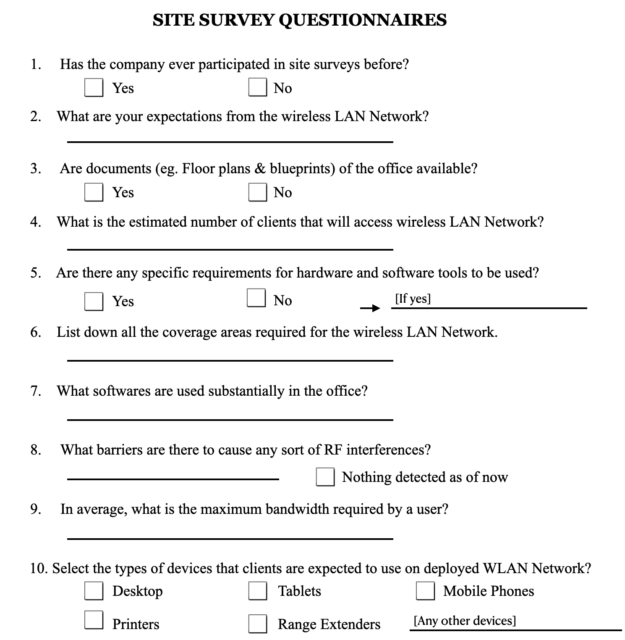
Requirement Elicitation
Company Requirements
Economically Feasible Deployment
Scalability Concerned
Tightly Secured
Sustainable Hardware and Softwares
Availability to both employees and clients
Site Survey Questionnaires

Slide 5
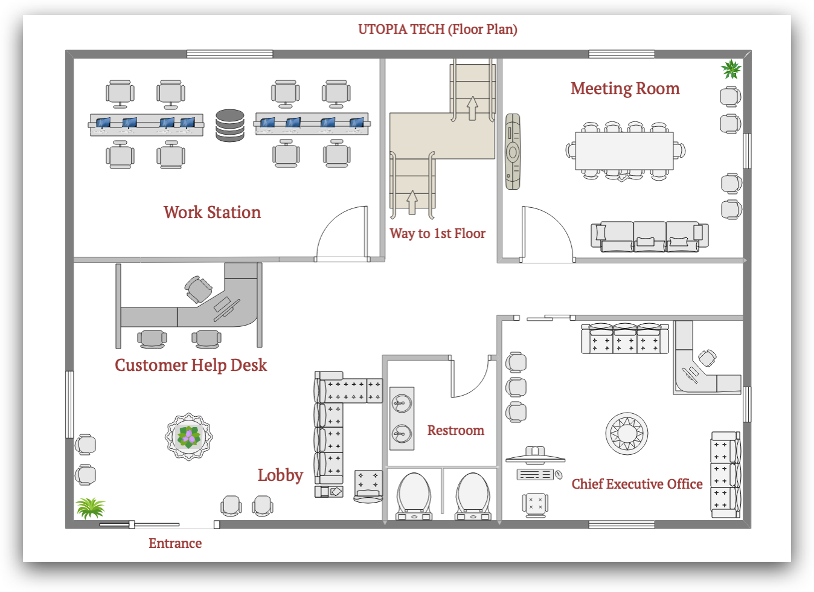
Site Survey : Floor Plan
Constructed using EdrawMax Application

Slide 6
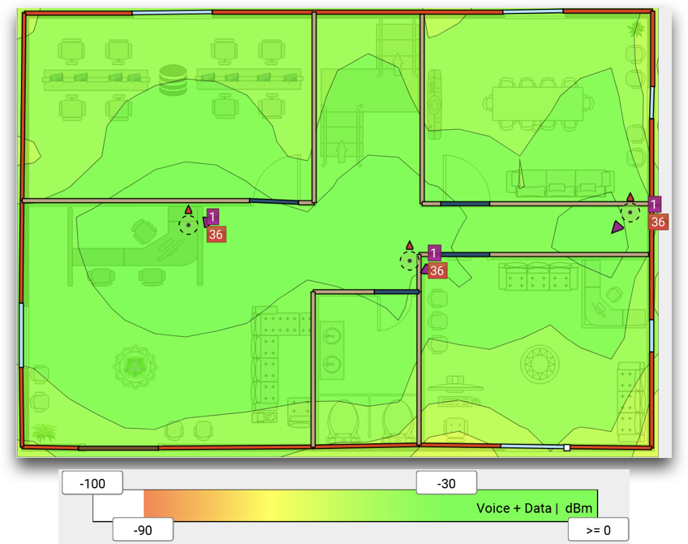
Site Survey
Concrete Wall
Dry Wall
Solid Wood Door
Thick Glass Window
Constructed using Ekahau Site Survey Application
Generated Heat map

Slide 7
WLAN Users
Users | Minimum Users | Maximum Users
Employees | 5 | 12
Clients | 0 | 8
Application to be Used
Application Name | Usage
Microsoft 365 | Communication & Document Sharing
Google G Suite | Professional Emails and Sheets to Employees
Slack | Marketing Purpose
Visual Studio Code | Coding and Backend Purposes
Adobe InDesign | Creation of Graphics and Flyers
Microsoft Access | As a Database Management software

Slide 8
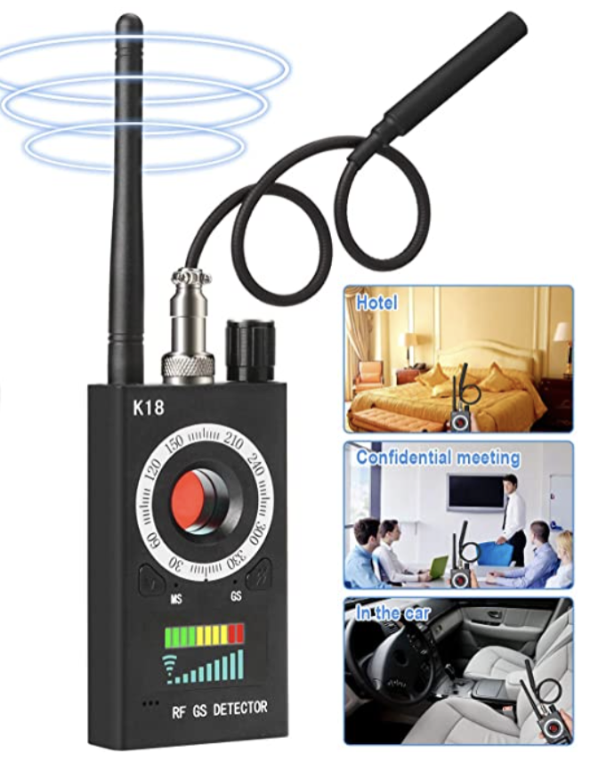
Visual LoS
Line of Sight
Radio LoS
Interference
Intrusion due to excessive radio spectrum occupancy
Might occur due to high amount of transmitters or monitors
Can create disarrangements in connections
Fig. Data Flagging Equipment
(Innoo Tech, 2021)

Slide 9
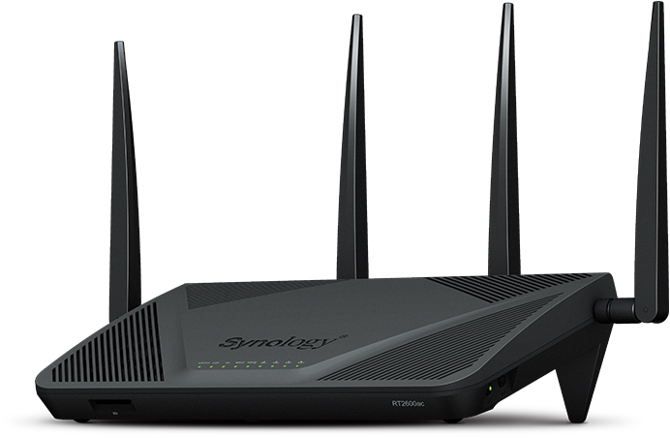
Hardware Requirements
Features
Router
Dual Band Router
MU-MIMO data streaming
Supports wireless type of 802.11ac
Data transfer rate of 1 GB/sec
Powerful with high voltage
Synology RT2600ac
Scalable and business-grade protected
(Synology Inc., n.d.)

Slide 10
Hardware Requirements
Access Point
Features
Secured and Scalable
UniFi controller to optimize RF performance
Compatible for indoor & outdoor operation
Supports 3X3 MIMO Tech
Ubiquiti UniFi Pro 802.11ac
(telco.sydney, n.d.)

Slide 11
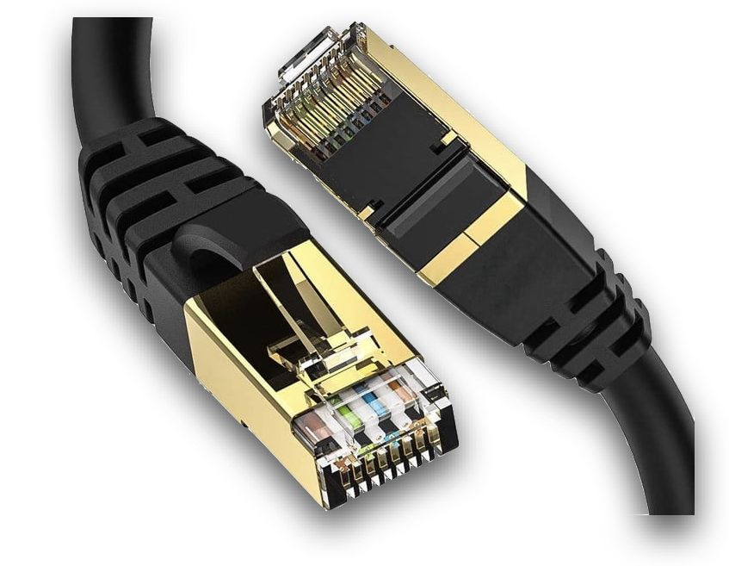
Hardware Requirements
Ethernet Cable
Features
Connects Access Points to Router
Throughput between 10 Gbps - 40 Gbps
STP Cables
Electromagnetic wave transmission
DiBillion Da Ethernet Cable
(Parrish, 2021)

Slide 12
Software Requirements
Intrusion Detection System
Antivirus
Open WIPS-NG
AVG
Free NIDS for WLAN
Anti-Phishing
Open source tools
System Booster
Sensors and immediate reports
Ransomware Security
GUI info display feature
File Shredder
Designed for SOHO businesses

Slide 13
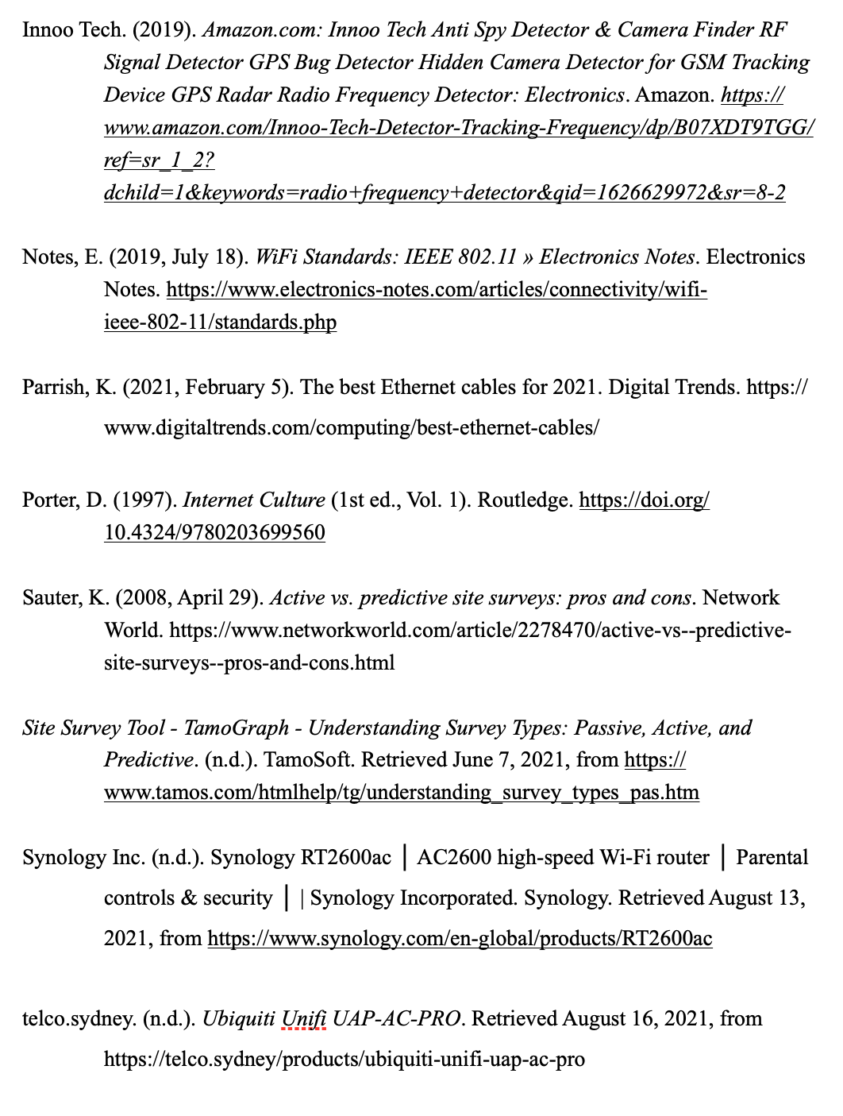
References

Slide 14
End of Presentation
Thank You !

